Slide 1


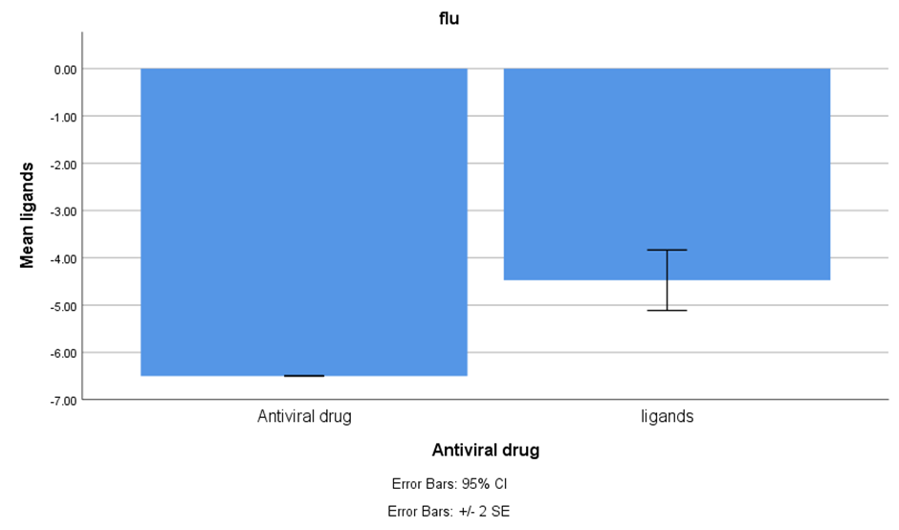
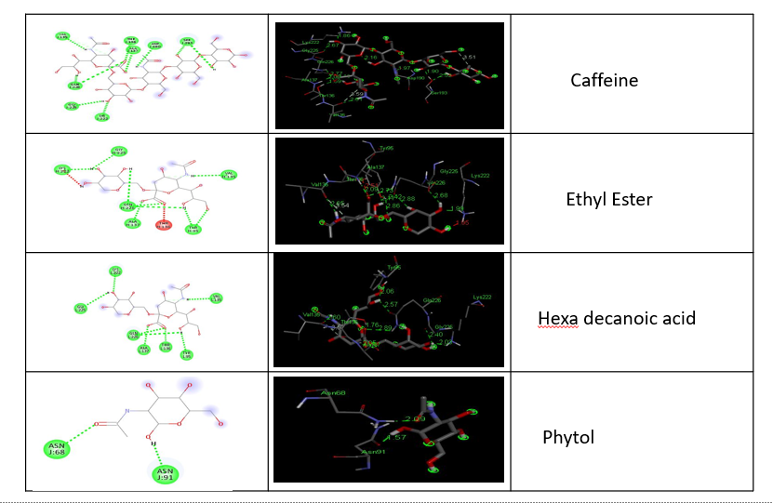
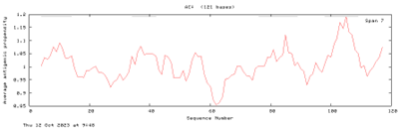
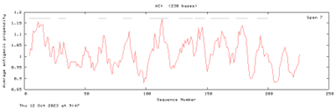
Name: Ms. Nellepalli Jahnavi Register Number: 192119043
Guided by Dr. K. Vaidhegi
Ms. Poorani.S
Guided by Dr. Mary Valantina. G
Exploring insilico approaches for Ligand Identification in Cissus quadrangularis to develop a vaccine against flu (influenza) Related viruses
INTRODUCTION
Influenza, commonly referred to as "the flu," is a contagious ailment brought about by influenza viruses.
It predominantly affects the upper respiratory system, causing inflammation in the upper airways and trachea. This acute condition typically lingers for a week to ten days and tends to resolve on its own in generally healthy individuals.
This study embarks on an exploration of insilico approaches to identify potential ligands within Cissus quadrangularis for the development of a vaccine against flu-related viruses, particularly Influenza.
The study's sample size is N=4, and an 80% power level power analysis is executed, considering factors such as the enrollment ratio, an alpha error of 0.5, a threshold of 0.05%, and a 95% confidence interval.
Recent scientific investigations have unveiled the multifaceted benefits of this plant, extending to the promotion of bone health, relief from joint pain, and protection against chronic illnesses like heart disease and diabetes.
Cissus quadrangularis, an anciently revered plant, has a storied history of use in treating a wide range of conditions.
MATERIALS AND METHODS
Antigenic Properties
VaxiJen
Immunomedicine
Sequence Retrieval proteins in Flu(Influenza)
Functional
Algpred
Functional/Physiochemical Properties
2.0Alertropv
Physiochemical
Protparam
AA-prop
Structural Properties
SOPMA
PRO-SA
VADAR
RESULTS
File No. | Protein sequence | Antigenic properties
 |  | VaxiJen |  | Immunomedicine
 |  | Antigenic score Threshold = 0.4 | Antigenic nature | Average antigenic propensity | Antigenic determinants | Antigenic plot sequence
1 | H1N1-1 | 0.4921 | Probable antigen | 1.0123 | 10
2 | H1N1-2 | 0.3458 | Probable non antigen | 1.008 | 4
DISCUSSION AND CONCLUSION
Based on T-test Statistical analysis, the significance value of p=0.0028 (independent sample T - test p<0.05) is obtained and shows that there is a statistical significance between the group 1 and group 2.
This study delves into the investigation of the antigenic regions of the H1N1 protein in Influenza, which are pivotal for initiating infection and eliciting immune responses. The epitope characteristics were meticulously examined through structural and epitope modeling, with the epitope identified by the PDB ID 1RVT considered the most suitable receptor for targeting antiviral drugs against Influenza.
To conduct docking experiments for potential antiviral drugs, ligands were selected from phytochemicals found in Cissus quadrangularis due to the plant's noteworthy biological activity and appealing therapeutic qualities.
Through GC-MS analysis, four compounds were identified as ligands for docking studies: phytol, hexadecanoic acid, ethyl ester, and caffeine. These compounds were specifically chosen for their potential efficacy in interacting with the identified epitope and combating Influenza.
BIBLIOGRAPHY
Avula, Bharathi, Ji-Yeong Bae, Jianping Zhao, Yan-Hong Wang, Mei Wang, Zhihao Zhang, Zulfiqar Ali, Amar G. Chittiboyina, and Ikhlas A. Khan. 2021. “Quantitative Determination and Characterization of Polyphenols from Cissus Quadrangularis L. and Dietary Supplements Using UHPLC-PDA-MS, LC-QToF and HPTLC.” Journal of Pharmaceutical and Biomedical Analysis 199 (May): 114036.
Bafna, Piyush S., Payal H. Patil, Saurabh K. Maru, and Rakesh E. Mutha. 2021. “Cissus Quadrangularis L: A Comprehensive Multidisciplinary Review.” Journal of Ethnopharmacology 279 (October): 114355.
Butler, Declan. 2009. “Pandemic Flu: From the Front Lines: As the Novel H1N1 Pandemic Flu Virus Infects People Worldwide, Researchers in Some of the Affected Countries Describe in Their Own Words the Scientific and Public-Health Challenges They Face.” Nature 461 (September): 20+.
Honecker, Friedemann, and Sergey A. Dyshlovoy. 2018. Marine Compounds and Cancer. MDPI.
Riley, Christopher M., and Thomas W. Rosanske. 1996. Development and Validation of Analytical Methods. Elsevier.

